Slide 1

Full Stack Web Development

Slide 2
Full Stack Development
Setting up the “Context”

Slide 3
Full Stack Developer
Over 2 billion Websites
Need for enhanced customer experience
Approximately 4.54 billion active internet users
The Full Stack developer role is the No.1 position to be filled in 2020 according to 38% of hiring managers. This is closely followed by the role of a back-end developer.
Among one of the most in demand job profiles for B. Tech Graduates
Ability to work on both frond-end and back-end
Knowledge of a broad spectrum of technologies
Easy to learn
Provides a much wider understanding of the scope of the project
Creative flexibility
Handsome salary packages
The demand for full-stack developers will steadily increase in the market as new technologies emerge.

Slide 4
Full Stack Developer - Skills
A full-stack developer is someone who is familiar with all layers of an application. These layers are really collections of various technologies needed to complete a project, which is where the term “stack” comes from.
Presentation layer: Also called the front-end, the presentation layer of an application involves everything that’s directly accessible by the end-user. These days, the presentation layer is typically created using HTML, CSS, JavaScript, jQuery, and various JavaScript libraries like React JS, Foundation, Backbone, AngularJS, and Ember.js.
Logic layer: Also called the back-end, the logic layer of an application involves any kind of development that doesn’t produce a user interface. Instead, it involves the core logic that makes everything work. Back-end developers are fluent in programming languages such as Python, Ruby, Java, PHP, and .Net.
Data layer: Sometimes described as a sub-group of the logic layer, the data layer deals with how data is created, read, updated, and deleted using databases such as MySQL, SQL Server, PostgreSQL, and Oracle.

Slide 5
Full Stack Developer - Skills
Full Stack Developer Skills
These are mandatory skills:
Front-end skills: Basic front-end technologies like HTML, CSS, and JavaScript, along with front-end frameworks or third-party libraries such as Jquery, ReactJS.
Back-end skills: Strong knowledge in at least one server-side language/technology like Java, Python, NodeJS, Ruby or .Net. Experience with back-end frameworks such as ExpressJs is a big plus.
Databases: They should be efficient at handling data from databases like MySQL, MongoDB, Redis, Oracle and SQLServer.
Version control systems (VCS): Full stack developers must be aware of Git so that they can make appropriate changes to the codebase.
Basic design skills: Awareness about the basic prototype design and UI/UX design is essential to become a successful full stack developer.
Server and API: They should have adequate exposure to Apache or Linux servers as well as web services.

Slide 6
Full Stack Developer – Job Roles/Job Profiles
Front-End Developer – Front-end web development, also known as client-side development is the practice of producing HTML, CSS and JavaScript for a website or Web Application.
Back-End Developer – Back-end Development refers to the server-side development. It focuses on databases, scripting, website architecture.
Full Stack Developer – Full Stack Development requires proficiency in both front-end and back-end development.
User Experience designer – Designing interactions between system and user.
Software Developer/Engineer – A generalized profile usually it may refer to any of the above job requirement.
Web Designer – Web designer is the role of someone who formulates solutions to problems specific to the web environment based on the higher-level limitations of that environment.
DevOps engineer – Deploying the system to production servers, maintaining the system, creating and maintaining application development and production environments, and preparing for backup and recovery.

Slide 7
Front End Development
HTML

Slide 8
How Internet Works
Let’s take a look at this video, one of the best explanation we have so far.
https://www.youtube.com/watch?v=7_LPdttKXPc

Slide 9
HTML - Introduction
Hyper Text
Markup
Language
“HTML is the most basic building block of the Web. It defines the meaning and structure of web content.”
Why do we need HTML
To publish content/documents online with text, images, tables etc.
To access web resources using Hyperlinks
To create forms to collect user inputs
And the list goes on ..
Brief History
1991 - First invented by Sir Tim Berners Lee
1995 - HTML Working Group defined HTML 2.0
1997 - W3C Recommendation – HTML 3.2
1999 - W3C Recommendation – HTML 4.01
2017 W3C Recommendation – HTML 5.1
Latest - HTML 5
* HTML as described earlier is a markup language not a programming language, like Java, Ruby, PHP, etc. You need a web browser to view the HTML pages.

Slide 10



HTML - Introduction
HTML is the standard markup language for creating Web pages
HTML describes the structure of a Web page
HTML consists of a series of elements
HTML elements tell the browser how to display the content
HTML elements label pieces of content such as "this is a heading", "this is a paragraph", "this is a link", etc.
HTML
(Structure)
CSS
(Look and Feel)
JavaScript
(Behavior or Functionality)

Slide 11
Exercise - 1
HTML – Writing First HTML Page
Ex-1. Write a web page with Title “My First Web Page” and the display Text Paragraph “Hello World!”.
Editor – Notepad
Browser – Chrome
Basic Setup
HTML Editor – ATOM
and Learn About HTML Boiler Plate

Slide 12
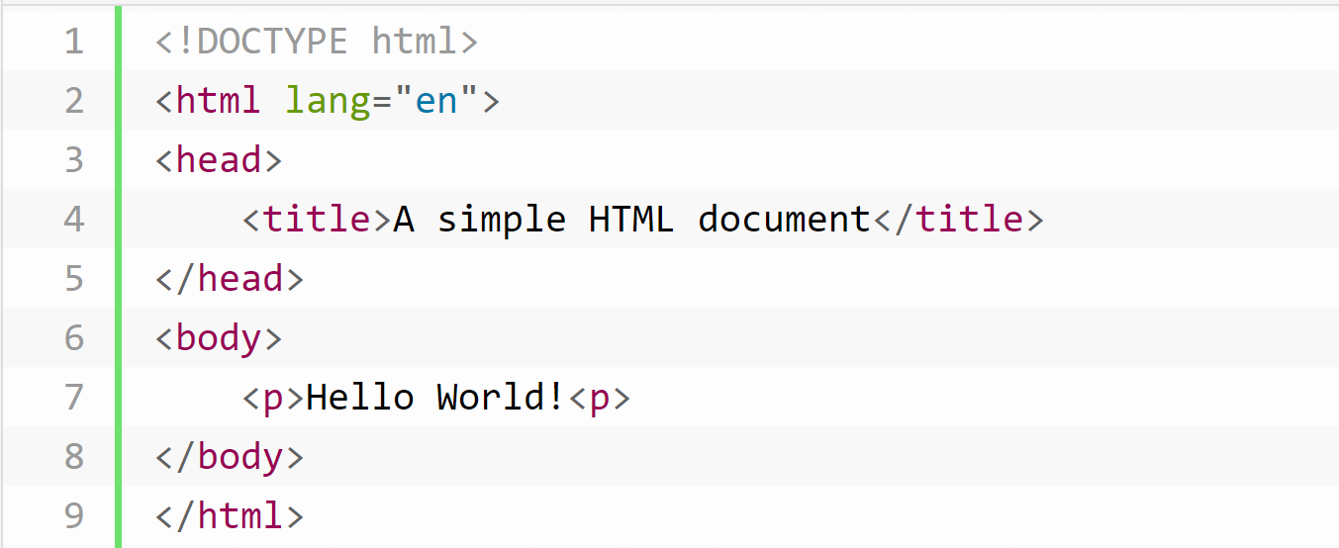
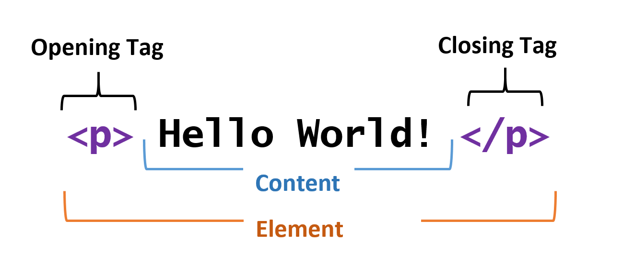
HTML – Structure of HTML
Anatomy of HTML
<!DOCTYPE HTML>
defines that this is an HTML5 Document
<html>
is the root element of an HTML Page
<head>
contains meta information
<title>
element specifies the title of the Page
<body>
element defines the document body
<p>
element defines a paragraph
Anatomy of an HTML Element

Slide 13
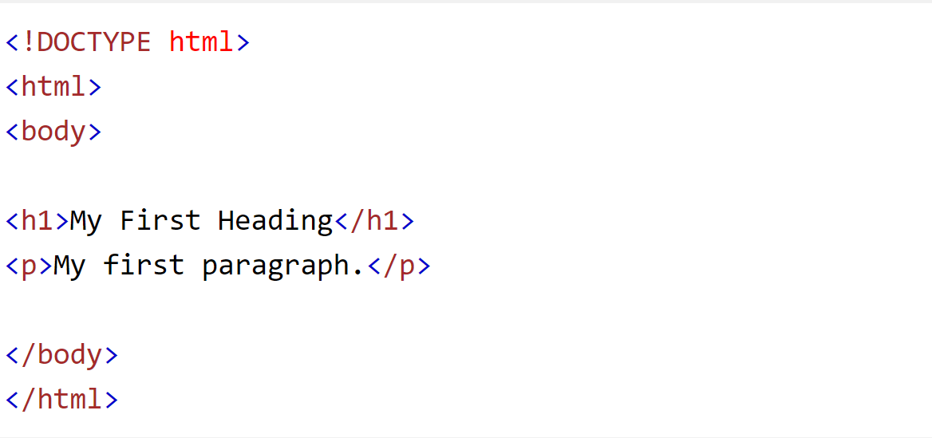
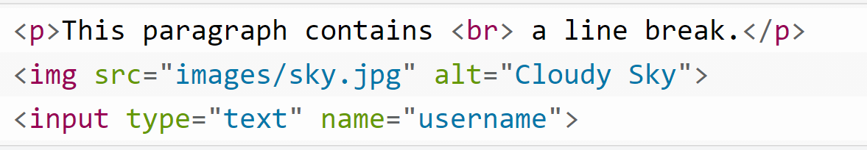
HTML - Elements
HTML Elements
Empty Elements
Nested Elements
Inline and Block elements
Nested Elements
All HTML documents consist of nested HTML elements
Most HTML elements can contain any number of further elements (except empty elements)
Example
Empty Elements
Empty elements (also called self-closing or void elements) are not container tags. i.e., you can not write <br> some content </br>
Example:

Slide 14
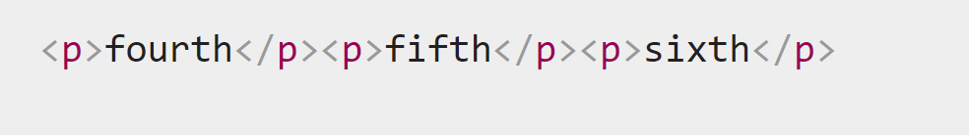
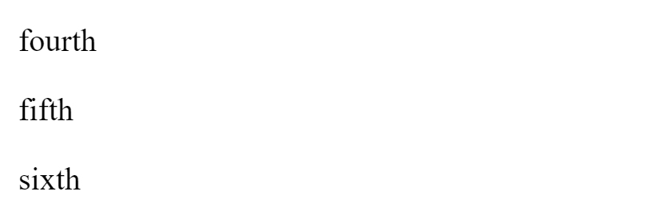
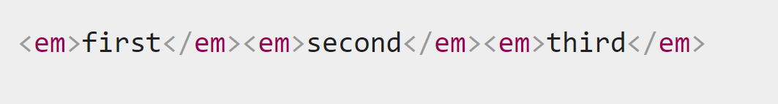

HTML – Elements
HTML Elements
Empty Elements
Nested Elements
Inline and Block Elements
Block Elements
All HTML documents consist of nested HTML elements
Most HTML elements can contain any number of further elements (except empty elements)
Example
Inline Elements
Inline elements are contained within block-level elements
An inline element will not cause a new line to appear in the document
Example:
Output
Output

Slide 15
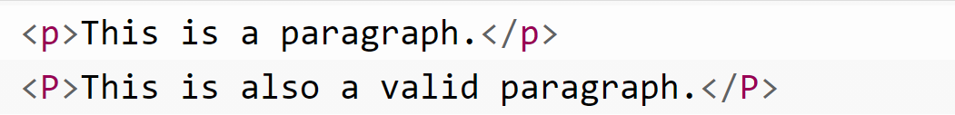
HTML - Elements
Block Elements
The most commonly used block-level elements are <div>, <p>, <h1> through <h6>, <form>, <ol>, <ul>, <li>, and so on.
The block-level elements should not be placed within inline-level elements. For example, the <p> element should not be placed inside the <b> element.
Inline Elements
The commonly used inline-level elements are <img>, <a>, <span>, <strong>, <b>, <em>, <i>, <code>, <input>, <button>, etc.
Case Insensitivity in HTML Tags and Attributes
In HTML, tag and attribute names are not case-sensitive (but most attribute values are case-sensitive)
However, it is strongly recommended to use lowercase for tag and attribute names. This will help to make sure the code is readable and compliant with future upgrades (XHTML is case sensitive).

Slide 16
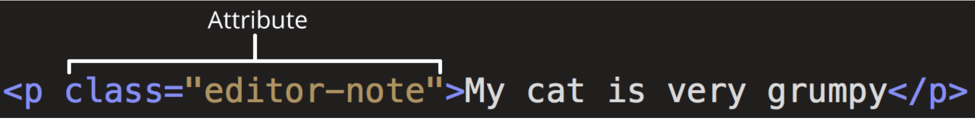
HTML - Attributes
HTML Attributes
All HTML elements can have attributes
Attributes provide additional information about elements
Attributes are always specified in the start tag
Attributes usually come in name/value pairs like: name="value"
An attribute should have:
A space between it and the element name. (For an element with more than one attribute, the attributes should be separated by spaces too.)
The attribute name, followed by an equal sign.
An attribute value, wrapped with opening and closing quote marks.

Slide 17
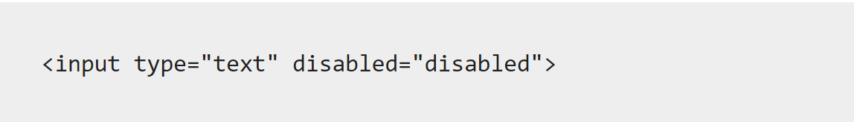
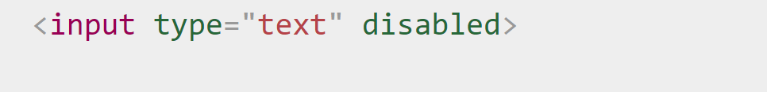
HTML - Attributes
Boolean Attributes
Boolean attributes can only have one value, which is generally the same as the attribute name. For example, consider the disabled attribute, which you can assign to form input elements. (You use this to disable the form input elements so the user can't make entries). For Example:
or
Some Commonly used Attributes
The href attribute in <a> tag
The src attribute in <img> tag
The width and height attribute in <img> tag
The alt attribute in <img> tag
The style attribute in <p> tag
The title attribute in <p> tag

Slide 18
HTML - Images
<img> tag
The <img> tag is used to embed an image in a web page.
Images are not technically inserted into a web page; images are linked to web pages. The <img> tag creates a holding space for the referenced image.
The <img> tag is an empty tag, it contains attributes only, and does not have a closing tag.
The <img> tag has two required attributes:
src - Specifies the path to the image
alt - Specifies an alternate text for the image
<img src=“URL” alt=“alternate text”>
The src Attribute
The required src attribute specifies the path(URL) to the image.
The alt Attribute
The required alt attribute provides the alternate text for the image, in case image could not be rendered from the src location.

Slide 19
HTML - Images
Image Size – Width and Height
The style attribute is used to specify the width and height of an image on a web page.
Alternatively, you can use width and height attributes.
Rendering Image from a different folder
If you have your image in another folder (a sub-folder or in a folder having a completely different path), then you must include the “complete path” or “relative path” in the src attribute.
<img src=“c:/users/images/img.png” alt=“My Image”>

Slide 20
HTML - Links
Link Tag
The HTML <a> tag defines a hyperlink. It has the following syntax:
The most important attribute of the <a> element is the href attribute, which indicates the link's destination.
The link text is the part that will be visible to the reader.
Clicking on the link text, will send the reader to the specified URL address.
Bookmark Anchors
Creating bookmarks is a two-step process:
Add the id attribute on the element where you want to jump
Then use that id attribute value preceded by the hash sign (#) as the value of the href attribute of the <a> tag, as shown in the following example:

Slide 21
HTML - Links
Link Tag – The target attribute
By default, the linked page will be displayed in the current browser window. To change this, you must specify another target for the link.
The target attribute specifies where to open the linked document.
The target attribute can have one of the following values:
_self - Default. Opens the document in the same window/tab as it was clicked
_blank - Opens the document in a new window or tab
_parent - Opens the document in the parent frame
_top - Opens the document in the full body of the window
Example:

Slide 22
HTML - Styles
Style Attribute
The HTML style attribute is used to add styles to an element, such as color, font, size, and more.
<tagname style="property:value;">
The property is a CSS property. The value is a CSS value.
Commonly Used Properties
background-color for background color
color for text colors
font-family for text fonts
font-size for text sizes
text-align for text alignment
* We will cover style attribute in detail during CSS discussion

Slide 23
HTML - Styles
Aligning Text
Text Formatting Tags
<b> Bold Face </b>
<i> Italics </i>
<u> Underline </u>
<p> New Paragraph </p>
<br> Next Line or Line Break
The align attribute can be inserted in the <P> and <hn> tags to right justify, center, or left justify the text
Example:
<h1 align=center> Hello World </h1>
Changing the Font
<font face = “font_name”> … </font>
can be used to change the font of the enclosed text
To change the size of text
<font size=n> …. </font> where n is a number between 1 and 7

Slide 24
HTML - Tables
Tables can be used to display rows and columns of data, create multi-column text, captions for images, and sidebars
The <table> tag is used to create a table
The <tr> tag is used to add a row member
The <td> tag is used to add a column/cell member
Table Border
The border=n attribute allows you to add a border n pixels thick around the table
To make a solid border color, use the bordercolor=“color” attribute
To make a shaded colored border, use bordercolordark=“color” and bordercolorlight=“color”
Setting Width
When a Web browser displays a table, it often adds extra space. To eliminate this space use the width=n attribute in the <table> and <td> tags
A cell cannot be smaller than its contents
A table having width more than the browser window, will only result in table going out of the display area

Slide 25
Basic Setup to get Started
Google Chrome Browser
Atom Text Editor
List of Atom Plugins
emmet
csslint
pigments
atom-beautify
atom-ternjs
autoclose-html

